Slide 1
Price vs Socio-Economic
3

Slide 2
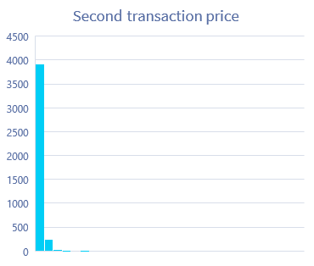
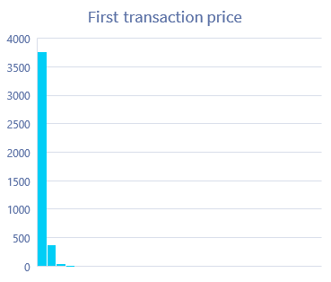
Normality
An assumption is made that the errors are normal.
We also know that the predicted value has a normal distribution under a fixed value of explanatory variables

Slide 3
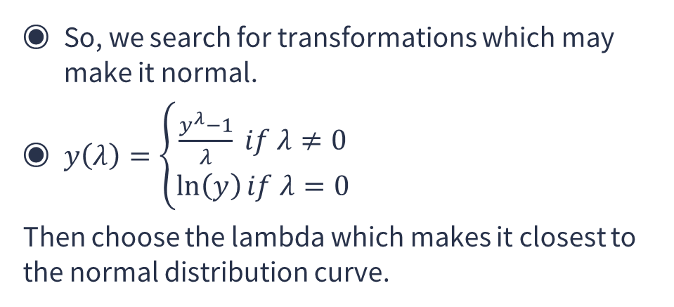
Box Cox Transformations
So, we search for transformations which may make it normal.
$y\left(λ\right)=\left\{\begin{aligned}\frac{y^{λ}−1}{λ} if λ≠0 \\ \ln\left(y\right)if λ=0\end{aligned}\right.$
Then choose the lambda which makes it closest to the normal distribution curve.

Slide 4

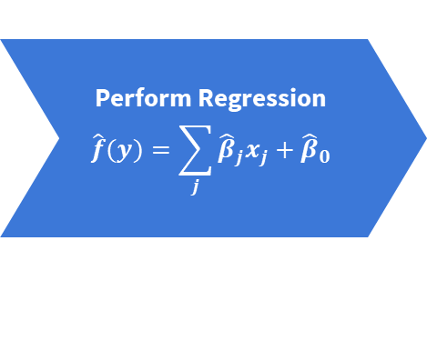

OUR PROCESS IS EASY
$$y$$
$$f(y)$$
Perform Regression
$$\hat{f}(y)=\sum_{j}{{\hat{β}}_{j}x_{j}}+{\hat{β}}_{0}$$

Slide 7
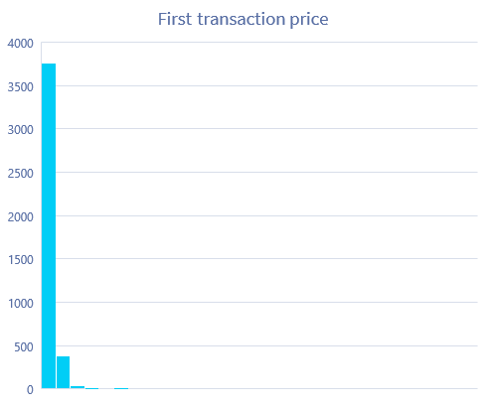

$$ln⁡(y)$$

Slide 8
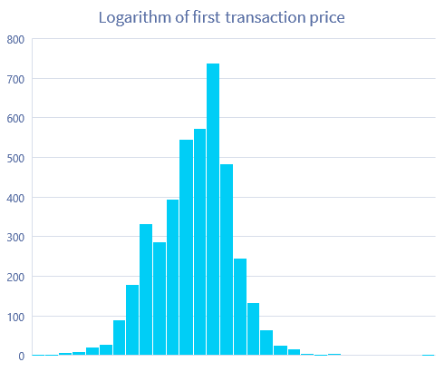

Slide 9
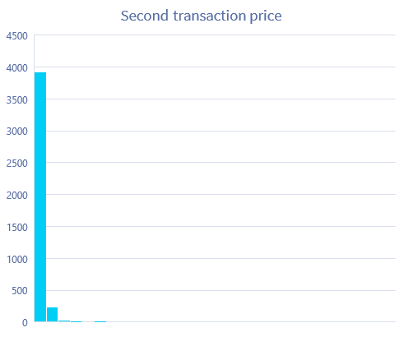
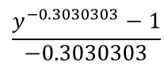
$$\frac{y^{−0.3030303}−1}{−0.3030303}$$

Slide 10
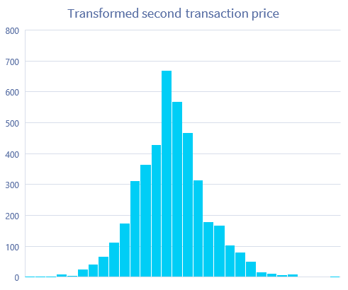

Slide 13
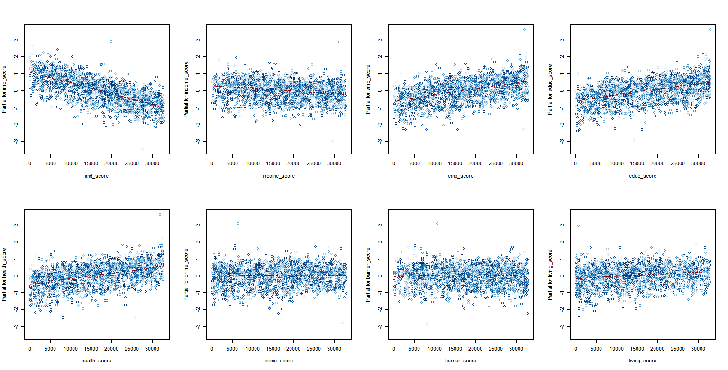
Partial Residue Plots for Price 1

Slide 14
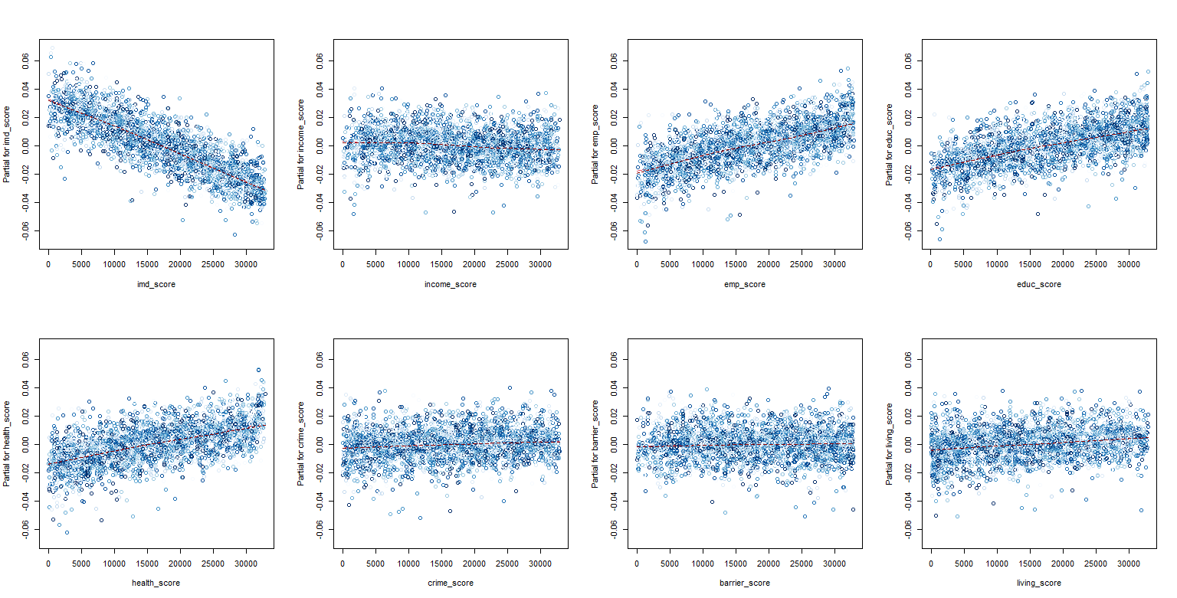
Partial Residue Plots for Price 2

Slide 15
Repeated Sales Index
4

Slide 16
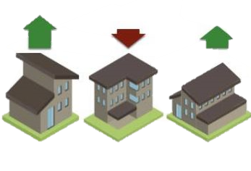
Key Ideas
Was developed by MARTIN J. BAILEY RICHARD F. MUTH AND HUGH O. NOURSE in 1963
An index to measure the change of prices over the years
The goal was to make sure that these indices are close to the change in prices of houses.

Slide 17
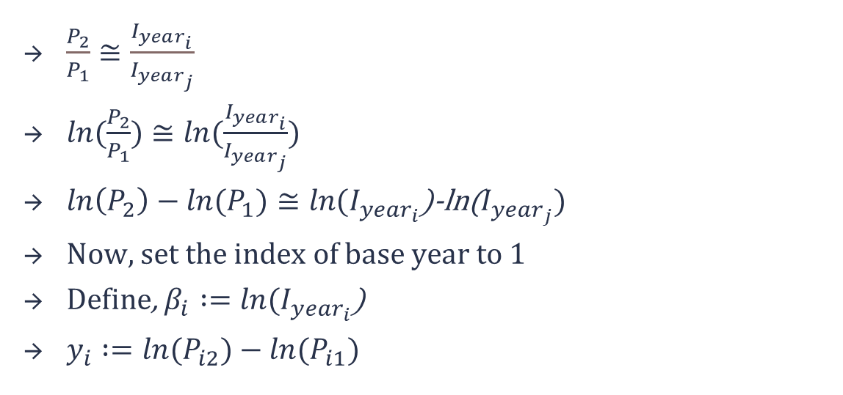
Theory
$\frac{P_{2}}{P_{1}}≅\frac{I_{year_{i}}}{I_{year_{j}}}$
$ln⁡(\frac{P_{2}}{P_{1}})≅ln⁡(\frac{I_{year_{i}}}{I_{year_{j}}})$
$\ln\left(P_{2}\right)−ln⁡(P_{1})≅ln⁡(I_{year_{i}}$)-ln($I_{year_{j}})$
Now, set the index of base year to 1
Define, $β_{i}∶=ln⁡(I_{year_{i}}$)
$y_{i}∶=ln⁡(P_{i2})−\ln{(P_{i1})}$

Slide 18
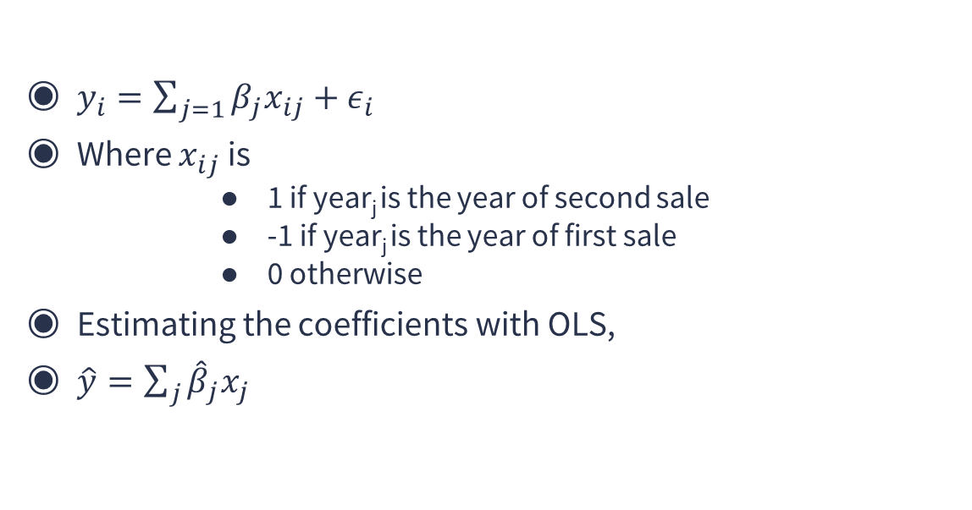
Procedure
$y_{i}=\sum_{j=1}{β_{j}x_{ij}}+ε_{i}$
Where $x_{ij}$ is
1 if year_{j} is the year of second sale
-1 if year_{j} is the year of first sale
0 otherwise
Estimating the coefficients with OLS,
$\hat{y}=\sum_{j}{{\hat{β}}_{j}x_{j}}$

Slide 19
Data Processing
Example
Year | Log Price_1 | Year | Log Price_2
2007 | 1 | 2008 | 2
2006 | 3 | 2007 | 7
2007 | 5 | 2008 | 9

Slide 20
Data Processing
Log Change | 2006 | 2007 | 2008
1 | 0 | -1 | 1
4 | -1 | 1 | 0
4 | 0 | -1 | 1

Slide 22
Conclusion
5

Slide 23
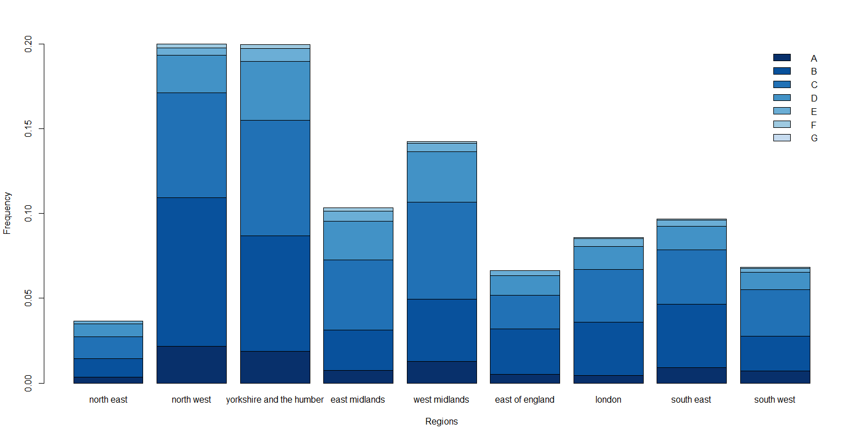
Future prospects

Slide 24
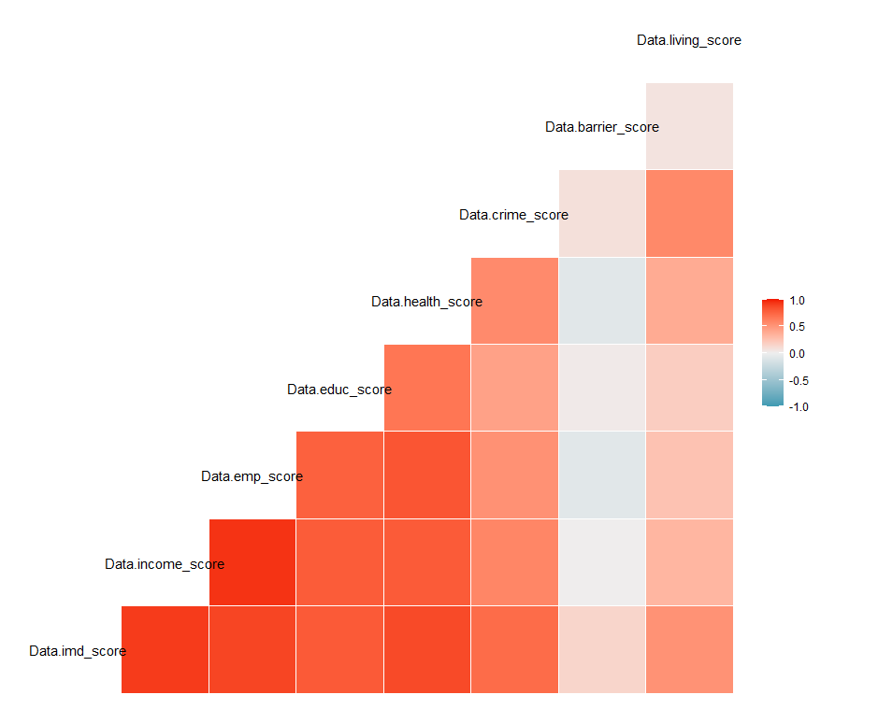
Future prospects

Slide 25
LIMITATIONS
The amount of data that needs to be collected and worked with for hedonic regression needs to be large. However, the used data had only 4201 values
Hedonic Price Index estimates people's willingness to pay for the supposed variation in environmental qualities and their consequences. However, if the people are unaware of the relation between the environmental qualities, then the value will not be reflected in the price of the property.
The RSI method is inefficient as it uses only information on units that have sold more than once during the sample period. Hence, a sample selection bias problem is induced.
If lambda is non-zero for price_2 in Box Cox Transformation so, the target variable is more difficult to interpret than if we simply applied a log transform.

Slide 26
SWOT ANALYSIS
STRENGTHS
Theoretical Analysis of every variable
WEAKNESSES
Many assumptions may not hold for the population
S
W
Better statistical methods can be used to get rid of assumptions
OPPORTUNITIES
The whole study was conducted for educational purposes
THREATS
O
T

Slide 27
References
Franz Fuerst, Michel Ferreira Cardia Haddad(2020). “Real estate data to analyse the relationship between property prices, sustainability levels and socio-economic indicators.” Data in Brief. 33 106359.
F. Fuerst, M.F.C. Haddad, H. Adan(2015). “Is there an economic case for energy-efficient dwellings in the UK private rental market?” Journal for Cleaner Prod. 245 (2020) 118642.
Bailey, M.J., Muth, R.F., Nourse, H.O. (1963). “A regression method for real estate price index construction. Journal of the American Statistical Association.” 58 933-942 16
G. E. P. Box and D. R. Cox(1964). “An Analysis of Transformations.” Journal of the Royal Statistical Society. Series B Vol. 26. No. 2.
Repeat Sales House Price Index Methodology. Journal of Real Estate Literature. Vol. 22, No. 1 (2014), pp. 23-46.
F. Fuerst , P. McAllister , A. Nanda , P. Wyatt(2015). “Does energy efficiency matter to home-buyers? an investigation of EPC ratings and transaction prices in England?” Energy Economy. 48 145–156 .

Slide 28
Acknowledgements
We would like to thank Dr. Rituparna Sen for her invaluable support as a mentor, and for providing us with an opportunity to delve deeper into the subject. We would also like to thank the authors for their comprehensive work on the subject. Lastly, we would like to thank our some of our classmates, discussing doubts with whom made it easier to navigate whenever we hit roadblocks.

Slide 29
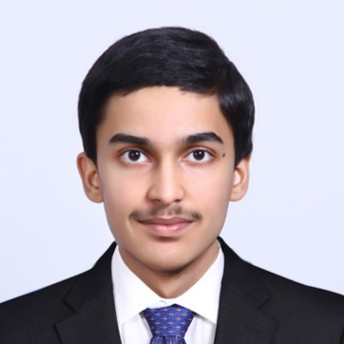



TEAM PRESENTATION
Aprameya G. Hebbar B Math 2nd Year
Atreya CHoudhury B Math 2nd Year
Sanchayan Bhowal
B Math 2nd Year
Shreyan Saha B Math 2nd Year

Slide 30
THANKS!
Any questions?

Slide 31
SlidesCarnival icons are editable shapes.
This means that you can:
Resize them without losing quality.
Change fill color and opacity.
Change line color, width and style.
Isn’t that nice? :)
Examples:

Slide 32
DIAGRAMS AND INFOGRAPHICS

